Slide 1
Living the D-Life
Disciple-Making. Anytime. Anywhere.
Welcome to D-Life Boot Camp

Slide 2
Living the D-Life
D-Life Overview
Mark 3:13-15
Lesson 1

Slide 3
What is your purpose?

Slide 4
What is your purpose?
According to Jesus, it is one main thing.

Slide 5
What is your purpose?
According to Jesus, it is one main thing.
It’s two words.

Slide 6
What is your purpose?
According to Jesus, it is one main thing.
It’s two words.
Your purpose is to MAKE DISCIPLES.

Slide 7
Every follower of Christ lives under the crystal-clear mandate of the Great Commission. There are no exceptions.

Slide 8
Main Thought…
Disciple-making is not
a program; it’s a lifestyle.

Slide 9
Mark 3:13-15
He went up on the mountain and called to Him those whom He desired, and they came to Him. And He appointed twelve…so that they might be with Him and He might send them out to preach and have authority to cast out demons.

Slide 10
Disciple-making is our supreme purpose in life (v. 13).
For Jesus, disciple-making was a first priority.
“He went up on the mountain and called to Him those He desired.”

Slide 11
Disciple-making is our supreme purpose in life (v. 13).
It was Jesus’ first command to His followers (Matthew 4:19).

Slide 12
Matthew 4:19
He said to them, “Follow me, and I will make you fishers of men.”

Slide 13
Disciple-making is our supreme purpose in life (v. 13).
It was Jesus’ first command to His followers (Matthew 4:19).
It was Jesus’ final command to His followers (Matthew 28:18-20).

Slide 14
Matthew 28:19-20
Go therefore and make disciples of all nations, baptizing them in the name of the Father and of the Son and of the Holy Spirit, teaching them to observe all that I have commanded you. And behold, I am with you always, to the end of the age.

Slide 15
The Great Commission is not a great suggestion.

Slide 16
Disciple-making has a simple process to follow (v. 14a).
For Jesus, disciple-making was a simple process.
“He appointed twelve…so that they might be with Him.”

Slide 17
Jesus modeled it for us.
From Jesus, we learn that disciple-making works best through the caring relational environment of a small discipleship group or “D-Group.”

Slide 18
A D-Group
For us, a D-Group could be as small as three to five people who meet anytime and anywhere for intentional discipleship.

Slide 19
By reading the Gospels, we learn there are six practices of disciple-making that Jesus modeled for us with His D-Group.

Slide 20
The 6 Practices of Disciple-Making
Fellowship
He called His disciples to have intimate fellowship with Him.

Slide 21
The 6 Practices of Disciple-Making
Fellowship
Teaching
He taught His disciples using stories and group discussions.

Slide 22
The 6 Practices of Disciple-Making
Fellowship
Teaching
Prayer
He prayed with His disciples and taught them to pray.

Slide 23
The 6 Practices of Disciple-Making
Fellowship
Teaching
Prayer
Ministry
He led His disciples out to do ministry and evangelism.

Slide 24
The 6 Practices of Disciple-Making
Fellowship
Teaching
Prayer
Ministry
Multiplication
He trained His disciples to make other disciples.

Slide 25
The 6 Practices of Disciple-Making
Fellowship
Teaching
Prayer
Ministry
Multiplication
Accountability
He held His disciples accountable to the process.

Slide 26
John 13:15
For I have given you an example, that you also should do just as I have done to you.

Slide 27
Disciple-making has the spiritual power to transform lives (v. 14b-15).
For Jesus, disciple-making was transformational.
He sent His disciples out “to preach and have authority to cast out demons.”

Slide 28
Jesus made disciples who made disciples; He didn’t make any other kind.
He equipped these common men to be disciple makers and sent them out to do the work He trained them to do.

Slide 29
John 14:12
Truly, truly, I say to you, whoever believes in me will also do the works that I do; and greater works than these will he do, because I am going to the Father.

Slide 30
Disciple-making is the “greater work.”

Slide 31
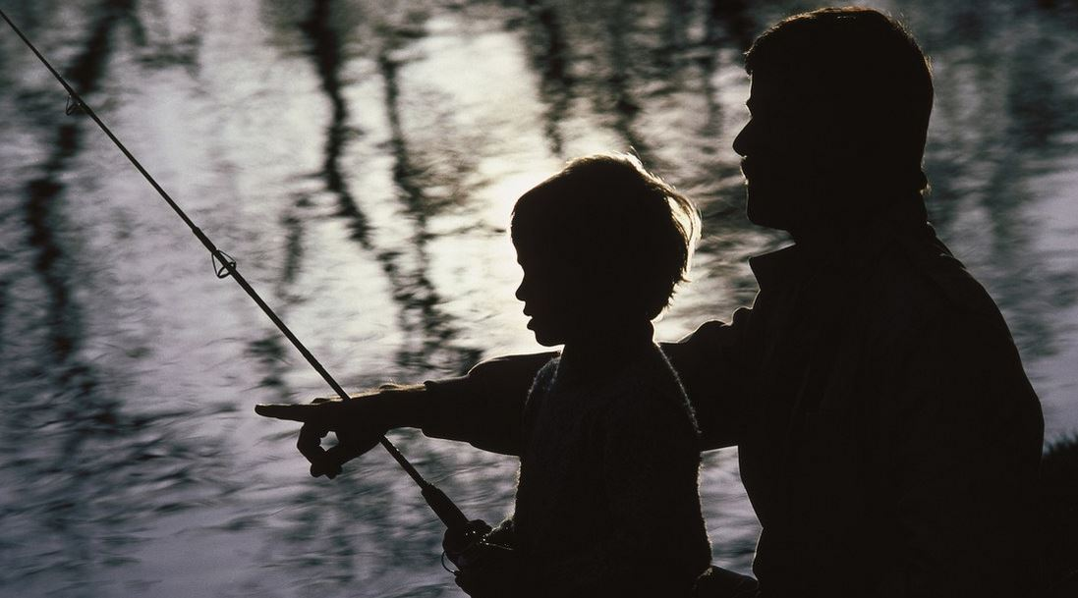
A Father, a Son, and a Zebco 33

Slide 32
The goal of D-Life is to equip common people to be Christ-like disciple makers.

Slide 33
Are you a follower of Jesus?
Are you willing to become a fisher of men?

Slide 34
Through D-Life, our vision is to see a global grassroots disciple-making movement.
We want you to join the movement!

Slide 35
Takeaways…
Disciple-making is not a program; it’s a lifestyle.
Disciple-making is our supreme purpose in life.
Disciple-making has a simple process to follow.
continued…

Slide 36
Takeaways…
Disciple-making has the spiritual power to transform lives.
Disciple-making is the greater work.

Slide 37
The 6 Practices of Disciple-Making
Part 1

Slide 38
The Fellowship of D-Life
Disciple-Making Practice #1
Mark 3:16-19
Lesson 2

Slide 39
There are a lot of broken people in the world. For the most part, the church is not doing an effective job of reaching them.
Studies indicate that 6 to 10 thousand American churches close their doors every year.

Slide 40
How can this be?
Jesus said, “The harvest is plentiful, but the laborers are few; therefore pray earnestly to the Lord of the harvest to send out laborers into His harvest” (Matthew 9:37).

Slide 41
From Jesus, we have learned that disciple-making is not a program; it’s a lifestyle.
We have also learned that Christ-like disciple-making works best through the caring relational environment of a small discipleship group or “D-Group.”

Slide 42
A D-Group
For us, a D-Group could be as small as three to five people who meet anytime and anywhere for intentional discipleship.

Slide 43
The first of the six practices of disciple-making that Jesus modeled is:
The Fellowship of Disciple-Making

Slide 44
The Fellowship of D-Life
It is hard to overstate the importance of relationships in one’s life. The Christian life is centered around relationships.

Slide 45
To make disciples like Jesus, you must you take the first step of calling together a discipleship group.

Slide 46
Main Thought…
Intimate fellowship with others is an essential part of disciple-making.

Slide 47
Mark 3:16-19
He appointed the twelve: Simon (to whom He gave the name Peter); James the son of Zebedee and John the brother of James (to whom He gave the name Boanerges, that is, Sons of Thunder); Andrew, Philip, Bartholomew, Matthew, Thomas, James the son of Alphaeus, Thaddaeus, Simon the Zealot, and Judas Iscariot, who betrayed Him.

Slide 48
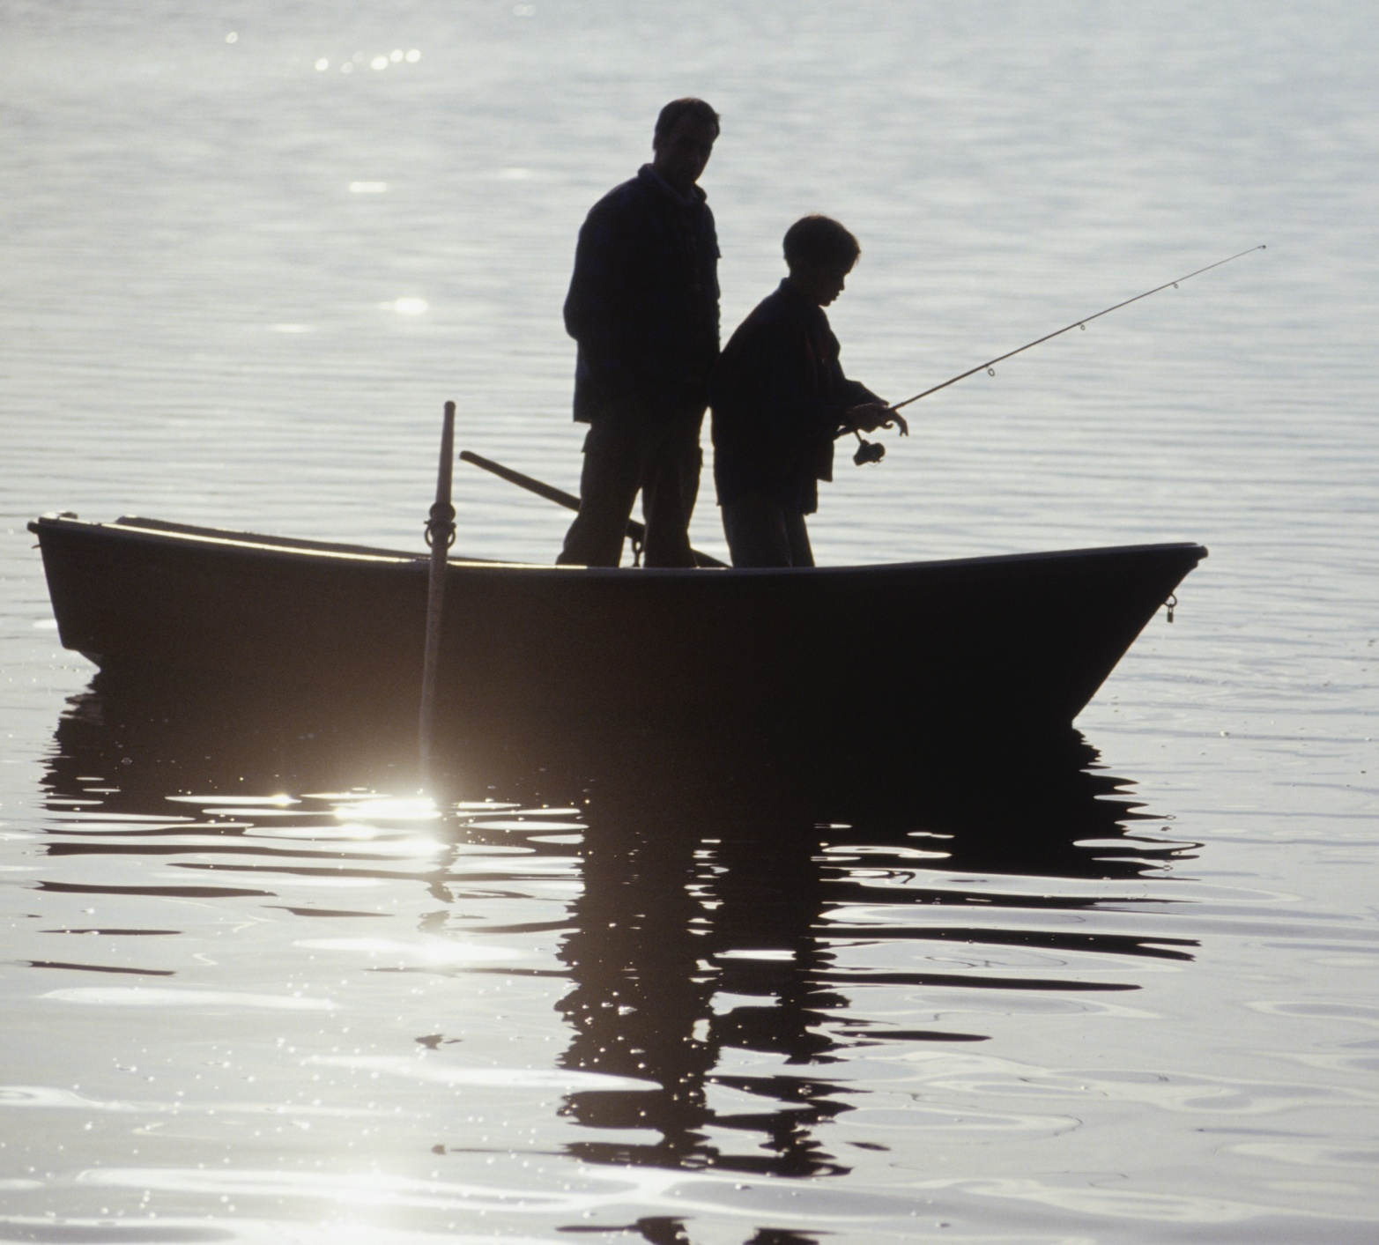
Choosing a D-Group must be intentional.
Jesus has called us to be “fishers of men.”
This involves more than merely announcing you are starting a D-Group. You must go fishing.

Slide 49
Choosing a D-Group must be intentional.
Understand the importance of prayer.

Slide 50
Choosing a D-Group must be intentional.
Understand the importance of prayer.
Understand the impact of hospitality.
“hospitality” – is philozenia. From philos, meaning “affection” and zenos, meaning “stranger.” Hospitality in the Bible literally means, “to show kindness to a stranger” (Heb. 3:2a).

Slide 51
Choosing a D-Group must be intentional.
Understand the importance of prayer.
Understand the impact of hospitality.
Understand the initiative of leadership.

Slide 52
Connecting with a D-Group will be imperative.
Your D-Group should meet weekly for fellowship, Bible study, and prayer. You can meet anytime and anywhere.
Consistency is important!

Slide 53
Characteristics of a D-Group will be important.
One thing you notice about the group of disciples whom Jesus called is their diversity.

Slide 54
Characteristics of a D-Group will be important.
You want a diverse group.
Mature Believers
New Believers
Unbelievers
Multi-Generational Believers

Slide 55
Characteristics of a D-Group will be important.
You want a diverse group.
You want a defective group.

Slide 56
Characteristics of a D-Group will be important.
You want a diverse group.
You want a defective group.
You want a dedicated group.

Slide 57
Takeaways…
Intimate fellowship with other believers is an essential part of disciple-making.
You must pray about who the Lord wants you to ask.
Practicing hospitality is critical.
continued…

Slide 58
Takeaways…
You must take the initiative to call people to join your group.
You want to have as much diversity as possible.
You must be a dedicated disciple maker.

Slide 59
Group Assignment
Where are your current “fishing holes?”
Where could you create some new fishing holes?

Slide 60
The Teaching of D-Life
Disciple-Making Practice #2
Mark 4:1-34
Lesson 3

Slide 61
A key word related to the teaching of D-Life is the word “simple.”

Slide 62
The D-Group Weekly Study Guide is a simple tool that provides a daily Bible reading plan and a weekly study guide for your D-Group (pgs. 15-16).

Slide 63
Main Thought…
Daily Bible reading, storytelling, and group discussion are the highly effective teaching techniques in disciple-making.

Slide 64
Mark 4:1-2a, 10
He began to teach beside the sea. And a very large crowd gathered about Him, so that He got into a boat . . . And He was teaching them many things in parables…. And when He was alone, those around Him with the twelve asked Him about the parables.

Slide 65
1. Lead your group to read the Bible.
To learn more about Jesus and to follow Him we must read the Bible. There is simply no substitute for daily Bible reading.

Slide 66
In D-Life, we have a very simple Bible reading plan.
Our goal is to read one chapter from the Bible, five days a week. This goal is so simple there is no excuse not to achieve it.

Slide 67
2. Lead your group to apply the Bible.
A major goal of daily Bible reading is personal application. Through D-Life, you will learn how to find personal application points from every chapter you read.

Slide 68
Personal Application Questions S-P-A-C-E
Is there a…
Sin to confess?
Promise to claim?
Attitude to change?
Command to obey?
Example to follow?

Slide 69
Group Assignment
Find a personal application from Matthew 4:18-25
Matthew 4 [Circle One: S P A C E ]
Personal Study Notes:
____________________________________________________________________
________________________________________________________________________________________________________________________________________________________________________________________________________________________________________________________________________________
Sin to Confess / Promise to Claim / Attitude to Change / Command to Obey / Example to Follow.

Slide 70
Weekly Accountability Questions
Did everyone read your daily Bible reading assignments?
What are some of the application points you found?

Slide 71
3. Lead your group to story through the Bible.
Any committed believer can teach like Jesus by using stories.

Slide 72
4. Lead your group to discuss the Bible.
When Jesus was alone with His disciples, they shared in group discussions where they would unwrap the meanings of His stories and teachings.

Slide 73
Facilitate the Bible Study Using the Weekly Study Guide Questions
Don’t talk too much.
Be encouraging.
Keep a good pace.
Get everyone in the group involved.

Slide 74
Facilitate the Bible Study Using the Weekly Study Guide Questions
Stop someone from dominating.
Stay on point.
Lead with sound biblical doctrine.
Always be confidential.

Slide 75
5. Lead your group to prepare to multiply.
Always remember that your ultimate goal as a D-Group Leader is to make disciples who make disciples.

Slide 76
Your D-Group Weekly Assignments
#1: Lead Prayer Time
#2: Tell the Story/Paraphrase
#3: Read the Text
#4: Facilitate Bible Study

Slide 77
Your D-Group Weekly Agenda
Fellowship Time
Prayer Time (Pray)
Accountability Time
Story Time (Tell)
Bible Reading (Read)
Bible Study (Facilitate)
Ministry Planning
Weekly Assignments
Closing Prayer

Slide 78
Your D-Group Disciple-Making Tools (Our Zebco 33 in Fishing for Men)
Your D-Life Disciple-Making tools will make it simple. These tools will equip and empower you for a lifestyle of disciple-making.

Slide 79
D-LIFE ONLINE
Four full years of D-Life Weekly Study Guides
Electronic / Printable (Pages 15 & 16)
Get your D-Life Online “Self Sign Up Link”

Slide 80
D-LIFE JOURNALS
New Testament 1 & 2
Old Testament 1 & 2

Slide 81
D-LIFE FOR FAMILIES
D-Life Boot Camps
Excellent Tool for Family
Discipleship by Josh Wilks

Slide 82
D-LIFE TRAINING
D-Life Boot Camps
Excellent Resources for Training your People

Slide 83
THE GREATER WORK
Great Book on Disciple-Making

Slide 84
SHARING JESUS, SHOWING KINDNESS
Great Book on Evangelism & Workshop with Dr. Alvin Reid

Slide 85
BROKENENSS TO BEAUTY BOOKLET
D-Life Boot Camps
Great Tool for Sharing Christ

Slide 86
THE REVIVE BIBLE NT
Another Great Tool for Sharing Christ

Slide 87
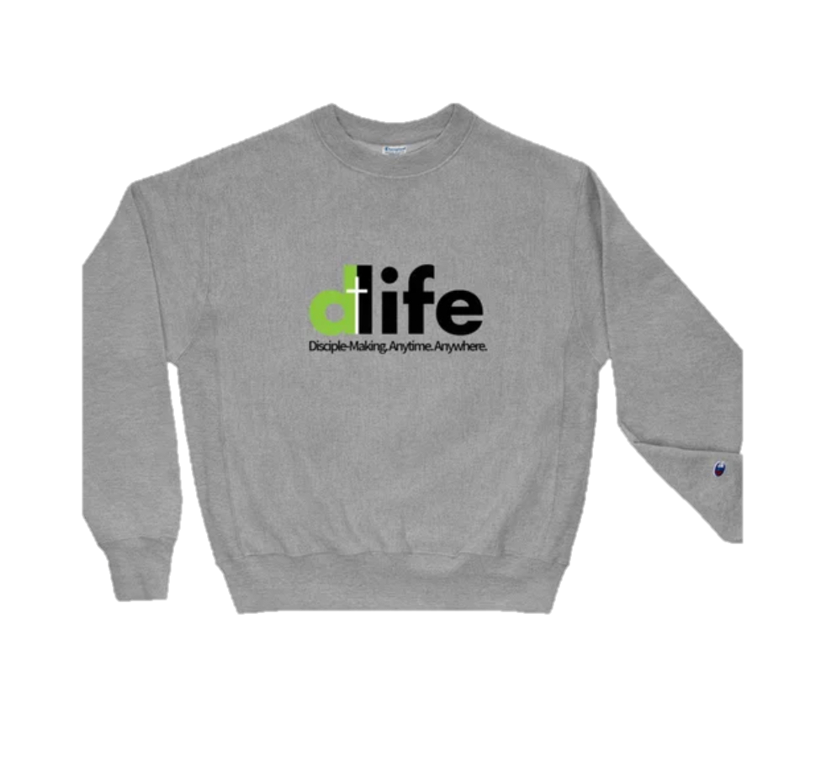
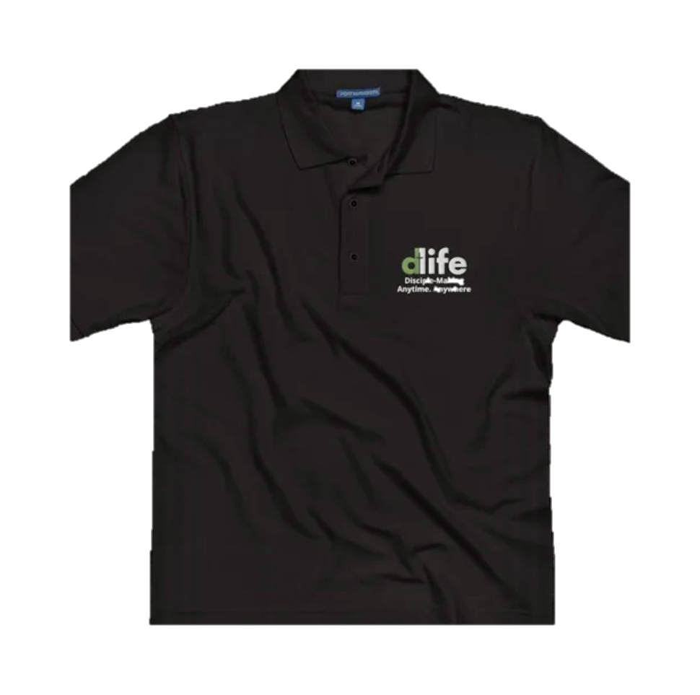
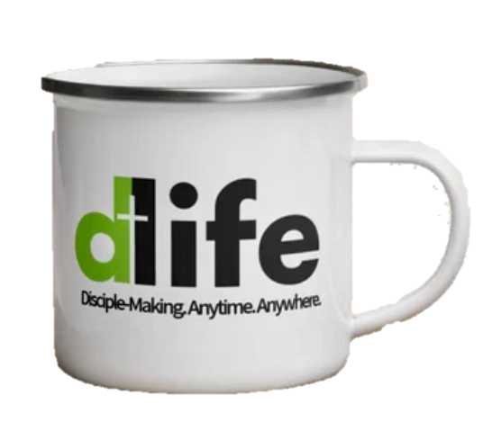
D-LIFE SHRITS & ACCESSORIES
A good way to share D-Life
with others.

Slide 88
For All of These Resources Visit the D-Life Online Store…
www.livethedlife.com/store

Slide 89
Follow Us on Facebook
www.facebook.com/livingthedlife
#dlife

Slide 90
Takeaways…
A key word related to the teaching of D-Life is the word simple.
Lead your group to read the Bible.
Lead your group to apply the Bible.
continued…

Slide 91
Takeaways…
Lead your group to story through the Bible.
Lead your group to discuss the Bible.
Lead your group to prepare to multiply.

Slide 92
Break Time
Men & Women’s Model D-Group Meetings
Sample 1 Study Guide (Page 15)
Sample 2 Study Guide (Page 16)

Slide 93
The 6 Practices of Disciple-Making
Part 2

Slide 94
The Prayer of D-Life
Disciple-Making Practice #3
Matthew 6:9-13
Lesson 4

Slide 95
So far, we have discussed the first two of the six practices of disciple-making.
Now let’s turn our attention to the third practice, which is The Prayer of D-Life.

Slide 96
Few things in life are more needed but more neglected than the power of fervent prayer.

Slide 97
Main Thought…
Disciple-making involves praying with others and practicing the discipline of prayer in our daily lives.

Slide 98
Matthew 6:9-13
Pray then like this: Our Father in heaven, hallowed be your name. Your kingdom come, your will be done, on earth as it is in heaven. Give us this day our daily bread, and forgive us our debts, as we also have forgiven our debtors. And lead us not into temptation, but deliver us from evil.

Slide 99
Teach your group the priority of prayer.
Prayer is a great privilege. We must not neglect it. In every D-Group we must teach and model the priority of fervent prayer.

Slide 100
Model for your group the practice of prayer.
As we pray together in our D-Groups, we learn the practice of prayer from one another.

Slide 101
A Model for Fervent Prayer
Adoration
Confession
Thanksgiving
Supplication

Slide 102
Nurture in your group faith in prayer.
One thing all D-Groups MUST do every time they meet is to pray for revival and the spiritual healing of our land.

Slide 103
2 Chronicles 7:14
If My people who are called by My name humble themselves, and pray and seek My face and turn from their wicked ways, then I will hear from heaven and will forgive their sin and heal their land.

Slide 104
Takeaways…
D-Groups must commit to the daily spiritual discipline of personal prayer.
D-Groups must pray together weekly and keep notes on prayer requests.
D-Groups must pray every week for revival and for the spiritual healing of our land.

Slide 105
The Ministry of D-Life
Disciple-Making Practice #4
Mark 6:7-13
Lesson 5

Slide 106
We deceive ourselves if we think we can disciple others from a classroom only.
Disciple-making requires a lab, and the world is our lab. Making disciples must involve on-the-job training in ministry and evangelism.

Slide 107
The 3-Fold Purpose of a D-Group
To grow in spiritual maturity.
To serve in missional ministry.
To reproduce disciple makers.

Slide 108
Main Thought…
Disciple-making involves doing the work of ministry and evangelism outside the walls of the church.

Slide 109
Mark 6:7, 12-13
He called the twelve and began to send them out two by two… So they went out and proclaimed that people should repent. And they cast out many demons and anointed with oil many who were sick and healed them.

Slide 110
Lead your group to plan meaningful ministry projects.
Jesus called His disciples to do the work of ministry and evangelism that they had observed Him doing.

Slide 111
Lead your group to go out and do meaningful ministry projects.
The MINIMUM GOAL of every D-Group is to work together on one community ministry and evangelism project every two months.

Slide 112
Lead your group to practice “lift up your eyes” evangelism.
The purpose of all D-Group ministry projects is servant evangelism.

Slide 113
THE REVIVE BIBLE NT
A practical tool
for sharing
the Gospel.
www.lifebiblestudy.com

Slide 114
“THE GOSPEL” ON D-LIFE ONLINE
Another tool for sharing the Gospel through D-Life Online.

Slide 115
When you lead others to Christ, try to immediately connect them with a D-Group.

Slide 116
Takeaways…
The 3-fold purpose of a D-Group is to grow in spiritual maturity, to serve in missional ministry, and to reproduce disciple makers.
Lead your group to plan meaningful ministry projects.
continued…

Slide 117
Takeaways…
Lead your group to go out and do meaningful ministry projects.
Lead your group to practice “life up your eyes” evangelism.
continued…

Slide 118
Takeaways…
The minimum goal of every D-Group is to work together on one community ministry and evangelism project every two months.

Slide 119
The Multiplication of D-Life
Disciple-Making Practice #5
2 Timothy 2:1-2
Lesson 6

Slide 120
The Kingdom principle of multiplying disciples is the most necessary and neglected practice of disciple-making.

Slide 121
Main Thought…
Disciple-making requires the multiplication of disciples; apart from multiplication there is no real discipleship.

Slide 122
2 Timothy 2:1-2
You then, my child, be strengthened by the grace that is in Christ Jesus, and what you have heard from me in the presence of many witnesses entrust to faithful men who will be able to teach others also.

Slide 123
Multiplication is empowered.
We can be filled with dynamite-like power for the purpose of multiplying disciples.

Slide 124
Multiplication is explained.
Multiplication is God’s plan for how His kingdom is to grow.

Slide 125
The Simple Plan
Every D-Group multiplies yearly.
Every D-Group has at least three disciples.

Slide 126
The Remarkable Results
Y1 = 1 D-Group / 3 Others
Y2 = 2 D-Groups / 6 Others
Y3 = 4 D-Groups / 12 Others
Y4 = 8 D-Groups / 24 Others

Slide 127
The Remarkable Results
Y05 = 16 D-Groups / 48 Others
Y10 = 512 D-Groups / 1,536 Others
Y20 = 524,228 D-Groups / 1,572,864 Others
Y30 = 500M< D-Groups / 1.5B< Others

Slide 128
Wow! What if only half of this happened?
Exponential kingdom growth is the ultimate result of multiplying disciples.

Slide 129
Multiplication is expected.
Paul had invested in Timothy. Now Timothy must invest in others for the disciple-making process to continue.

Slide 130
Multiplication is expected.
We must have the dedication of a soldier.

Slide 131
2 Timothy 2:3-4
Share in suffering as a good soldier of Christ Jesus. No soldier gets entangled in civilian pursuits, since his aim is to please the one who enlisted him.

Slide 132
Multiplication is expected.
We must have the dedication of a soldier.
We must have the discipline of an athlete.

Slide 133
2 Timothy 2:5
An athlete is not crowned unless he competes according to the rules.

Slide 134
Multiplication is expected.
We must have the dedication of a soldier.
We must have the discipline of an athlete.
We must have the diligence of a farmer.

Slide 135
2 Timothy 2:6-7
It is the hard-working farmer who ought to have the first share of the crops. Think over what I say, for the Lord will give you understanding in everything.

Slide 136
The greatest reward of disciple- making is multiplication.

Slide 137
Through D-Life you have four years of weekly study guides.
This gives you time to diligently equip those who are ready to lead and to patiently invest in those who need more growth.

Slide 138
The on-going training of new D-Group leaders is essential.
D-LIFE BOOT CAMP
TRAINING
Encourage new leaders to step up to lead.
Enlist new leaders for D-Life training.

Slide 139
Multiplication of is exciting.
A lifetime lifestyle of making and multiplying disciples is the ultimate D-Life commitment.

Slide 140
Takeaways…
Multiplying disciples is what God has called you to do.
Multiplying disciples is what God will empower you to do.
continued…

Slide 141
Takeaways…
Multiplying disciples is what God will reward you to do.
Multiplying disciples will result in the exponential growth of God’s kingdom.

Slide 142
The Accountability of D-Life
Disciple-Making Practice #6
Matthew
26:34-35
Lesson 7

Slide 143
Unfortunately, it is not uncommon for people to feel they are not up to the task for living a life of disciple-making.

Slide 144
Main Thought…
Disciple-making involves loving spiritual accountability in the context of a caring relational environment.

Slide 145
Matthew 26:34-35
Jesus said to him, “Truly, I tell you, this very night, before the rooster crows you will deny me three times.” Peter said to Him, “Even if I must die with you, I will not deny you!”

Slide 146
Lives are changed through spiritual accountability.
In our D-Groups, we hold one another accountable in three important areas of spiritual development.

Slide 147
Lives are changed through spiritual accountability.
Accountability to the Word of God.

Slide 148
Lives are changed through spiritual accountability.
Accountability to the Word of God.
Accountability to our walk with God.

Slide 149
Lives are changed through spiritual accountability.
Accountability to the Word of God.
Accountability to our walk with God.
Accountability to our work and witness for God.

Slide 150
Leaders are called through spiritual accountability.
Jesus’ example of loving accountability with Peter is an example to follow.

Slide 151
The Risen Jesus went to Peter to hold him accountable to his commitment.
Three times Peter denied Jesus, and three times Jesus said to Peter, “Feed my sheep” (John 21:3-17).

Slide 152
Regardless of Peter’s issues and failures, Jesus reminded him that he was called to be a disciple-maker.
The same is true for us. We have no good excuse to not live the D-Life.

Slide 153
Let us commit to a lifestyle of disciple-making.
To be a disciple maker is a priority commitment.

Slide 154
Let us commit to a lifestyle of disciple-making.
To be a disciple maker is a priority commitment.
To be a disciple maker is a personal commitment.

Slide 155
I pray that you will make a lifetime commitment to living the D-Life.

Slide 156
Takeaways…
Jesus has called you to be a disciple maker.
You are empowered to be a disciple maker.
Will you commit to be a disciple maker?

Slide 157
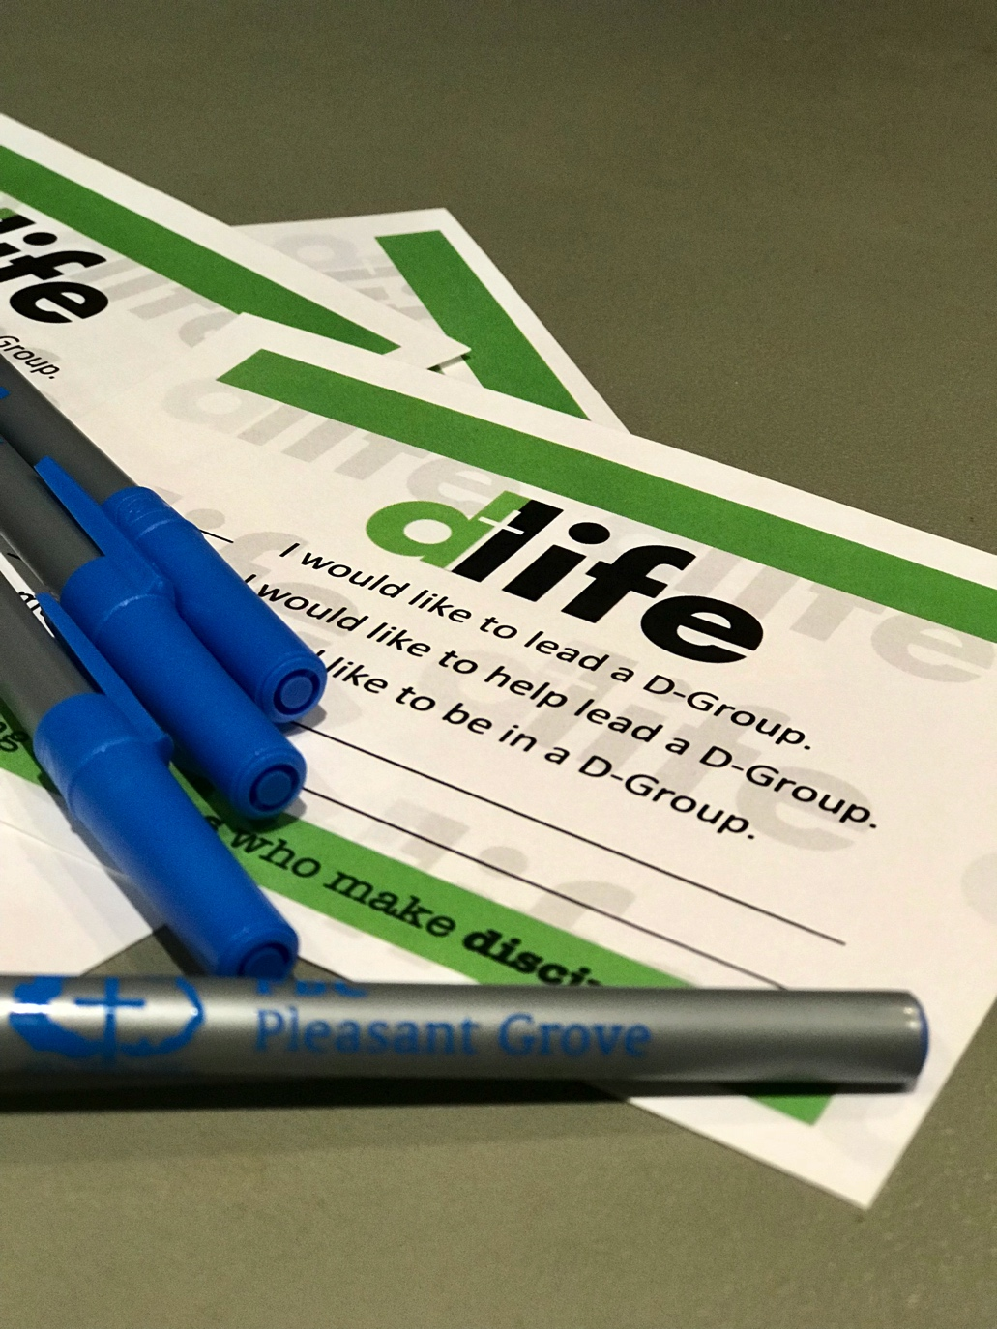
Group Assignment
Fill out your D-Life Commitment Card.
I would like to lead a D-Group.
I would like to help lead a D-Group.
I would like to be in a D-Group.

Slide 158
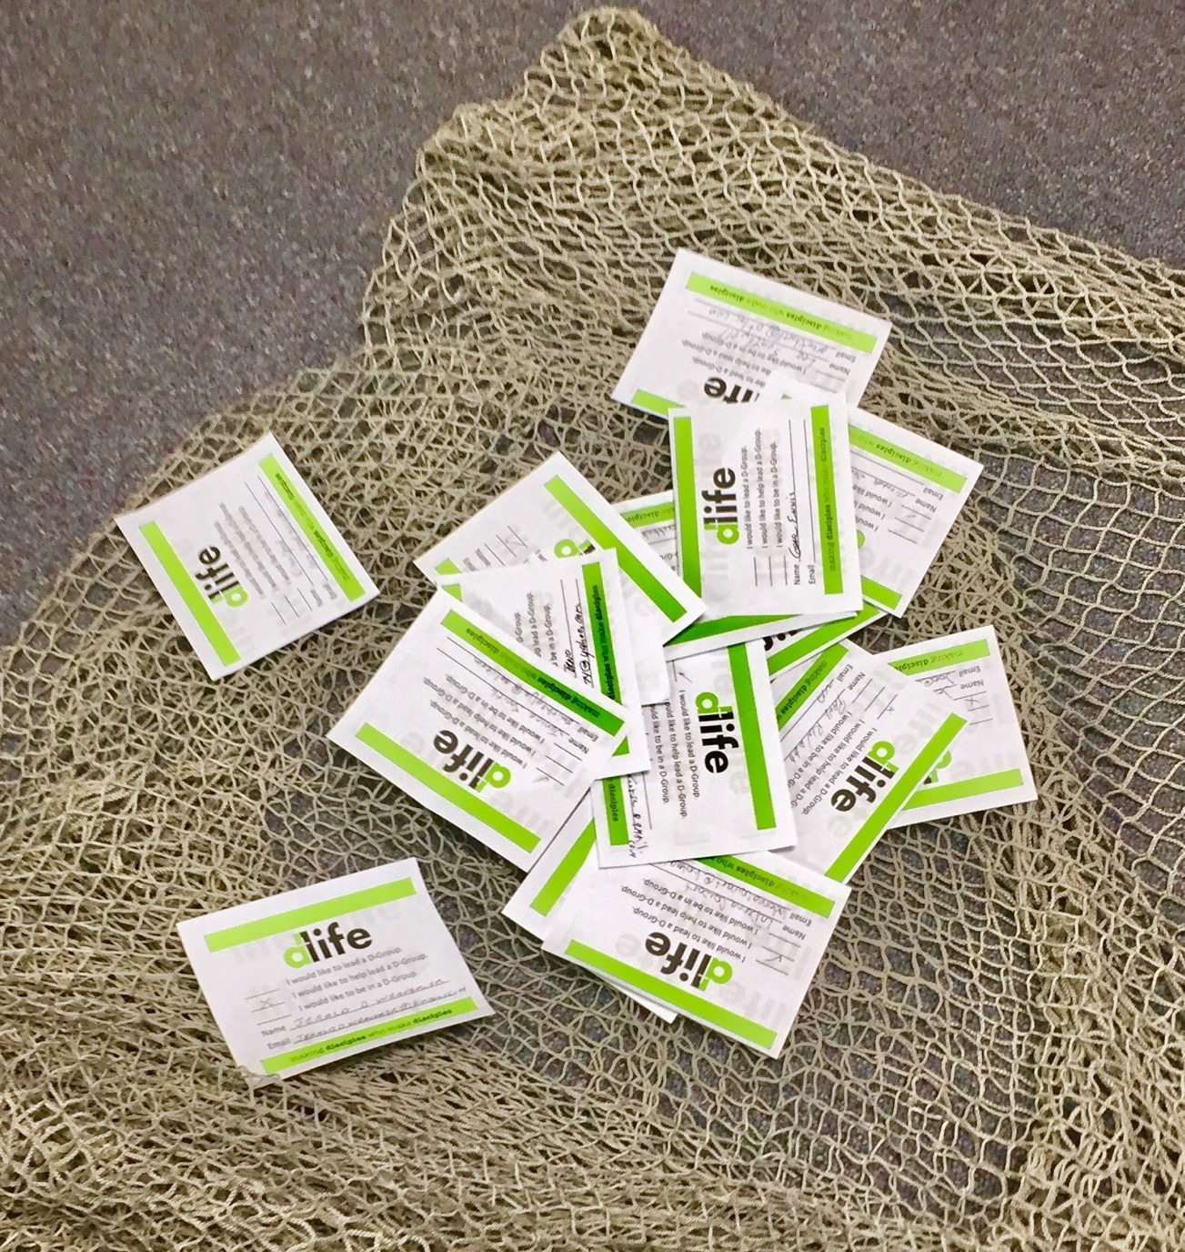
Group Assignment
Bring your card and lay it down in the net.

Slide 159
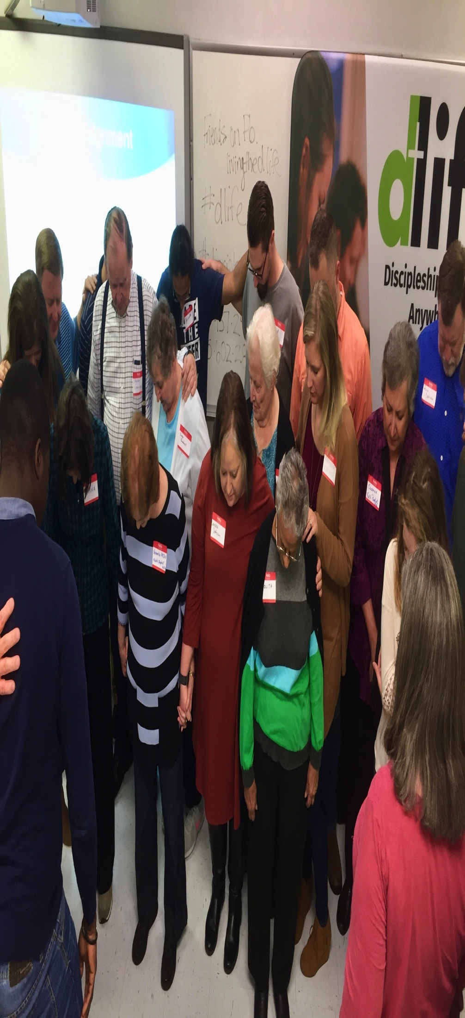
Group Assignment
Let’s pray for a mighty movement of God.

