Slide 1


Living the D-Life
Disciple-Making. Anytime. Anywhere.
Welcome to
D-Life Boot Camp

Slide 2

Living the D-Life
D-Life
Overview
Mark 3:13-15
Lesson 1

Slide 3

What is your purpose?

Slide 4
What is your purpose?
According to Jesus, it is one main thing.

Slide 5
What is your purpose?
According to Jesus, it is one main thing.
It’s two words.

Slide 6
What is your purpose?
According to Jesus, it is one main thing.
It’s two words.
Your purpose is to MAKE DISCIPLES.

Slide 7
Every follower of Christ lives under the crystal-clear mandate of the Great Commission. There are no exceptions.

Slide 8
Main Thought…
Disciple-making is not
a program; it’s a lifestyle.

Slide 9
Mark 3:13-15
He went up on the mountain and called to Him those whom He desired, and they came to Him. And He appointed twelve…so that they might be with Him and He might send them out to preach and have authority to cast out demons.

Slide 10
Disciple-making is our supreme purpose in life (v. 13).
For Jesus, disciple-making
was a first priority.
“He went up on the mountain and called to Him those He desired.”

Slide 11
Disciple-making is our supreme purpose in life (v. 13).
It was Jesus’ first command to His followers (Matthew 4:19).

Slide 12
Matthew 4:19
He said to them, “Follow me, and I will make you fishers of men.”

Slide 13
Disciple-making is our supreme purpose in life (v. 13).
It was Jesus’ first command to His followers (Matthew 4:19).
It was Jesus’ final command to His followers (Matthew 28:18-20).

Slide 14
Matthew 28:19-20
Go therefore and make disciples of all nations, baptizing them in the name of the Father and of the Son and of the Holy Spirit, teaching them to observe all that I
have commanded you. And behold, I am
with you always, to the end of the age.

Slide 15
The Great Commission
is not a great suggestion.

Slide 16
Disciple-making has a simple process to follow (v. 14a).
For Jesus, disciple-making
was a simple process.
“He appointed twelve…so that they might be with Him.”

Slide 17
Jesus modeled it for us.
From Jesus, we learn that disciple-making works best through the caring relational environment of a small discipleship group or “D-Group.”

Slide 18
A D-Group
For us, a D-Group could be as small
as three to five people who meet anytime and anywhere for intentional discipleship.

Slide 19
By reading the Gospels, we learn there are six practices of disciple-making that Jesus modeled for us with His D-Group.

Slide 20
The 6 Practices of Disciple-Making
Fellowship
He called His disciples to
have intimate fellowship with Him.

Slide 21
The 6 Practices of Disciple-Making
Fellowship
Teaching
He taught His disciples using stories
and group discussions.

Slide 22
The 6 Practices of Disciple-Making
Fellowship
Teaching
Prayer
He prayed with His disciples
and taught them to pray.

Slide 23
The 6 Practices of Disciple-Making
Fellowship
Teaching
Prayer
Ministry
He led His disciples out to do
ministry and evangelism.

Slide 24
The 6 Practices of Disciple-Making
Fellowship
Teaching
Prayer
Ministry
Multiplication
He trained His disciples
to make other disciples.

Slide 25
The 6 Practices of Disciple-Making
Fellowship
Teaching
Prayer
Ministry
Multiplication
Accountability
He held His disciples
accountable to the process.

Slide 26
John 13:15
For I have given you an example, that you also should do just as I have done to you.

Slide 27
Disciple-making has the spiritual power to transform lives (v. 14b-15).
For Jesus, disciple-making
was transformational.
He sent His disciples out “to preach and have authority to cast out demons.”

Slide 28
Jesus made disciples who made disciples; He didn’t make any other kind.
He equipped these common men to be disciple makers and sent them out to do the work He trained them to do.

Slide 29
John 14:12
Truly, truly, I say to you, whoever believes in me will also do the works that I do; and greater works than these will he do, because I am going to the Father.

Slide 30
Disciple-making is the “greater work.”

Slide 31
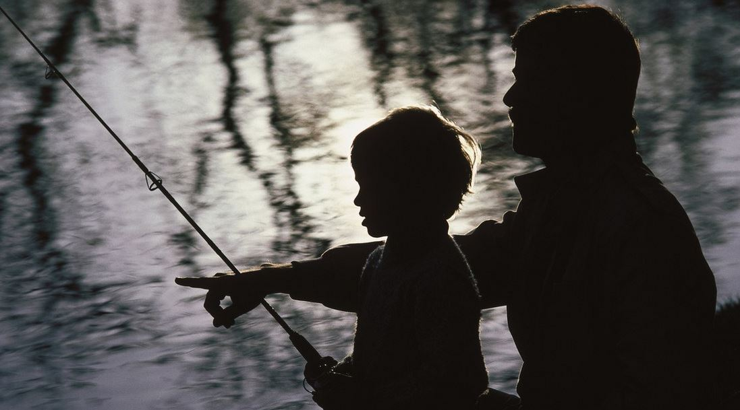
A Father, a Son, and a Zebco 33

Slide 32
The goal of D-Life is to equip common people to be Christ-like disciple makers.

Slide 33
Are you a follower of Jesus?
Are you willing to become a fisher of men?

Slide 34
Through D-Life, our vision is to see a global grassroots disciple-making movement.
We want you to join the movement!

Slide 35
Takeaways…
Disciple-making is not a program; it’s a lifestyle.
Disciple-making is our supreme purpose in life.
Disciple-making has a simple process to
follow.
continued…

Slide 36
Takeaways…
Disciple-making has the spiritual power to transform lives.
Disciple-making is the greater work.

Slide 37
The 6 Practices of Disciple-Making
Part 1

Slide 38
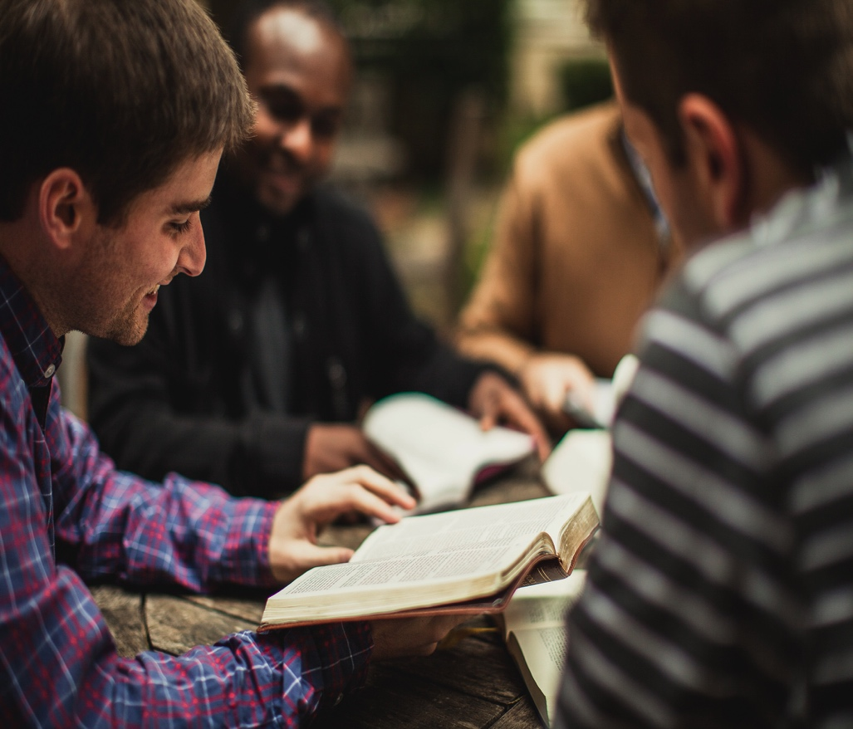
Fellowship
D-Life
Practice
#1
Mark 3:16-19
Lesson 2

Slide 39
It is hard to overstate the importance of relationships in
one’s life. True disciple-making is centered around relationships.

Slide 40
From Jesus, we have learned that disciple-making is not a program; it’s a lifestyle.
We have also learned that Christ-like disciple-making works best through the caring relational environment of a small discipleship group or “D-Group” of 3-5 people.

Slide 41
To make disciples like Jesus, you must you take the first step of calling together a discipleship group.

Slide 42
Main Thought…
Intimate fellowship with others is an essential part of disciple-making.

Slide 43
Mark 3:16-19
He appointed the twelve: Simon (to whom
He gave the name Peter); James the son of Zebedee and John the brother of James (to whom He gave the name Boanerges, that is, Sons of Thunder); Andrew, Philip, Bartholomew, Matthew, Thomas, James the son of Alphaeus, Thaddaeus, Simon the Zealot, and Judas Iscariot, who betrayed Him.

Slide 44
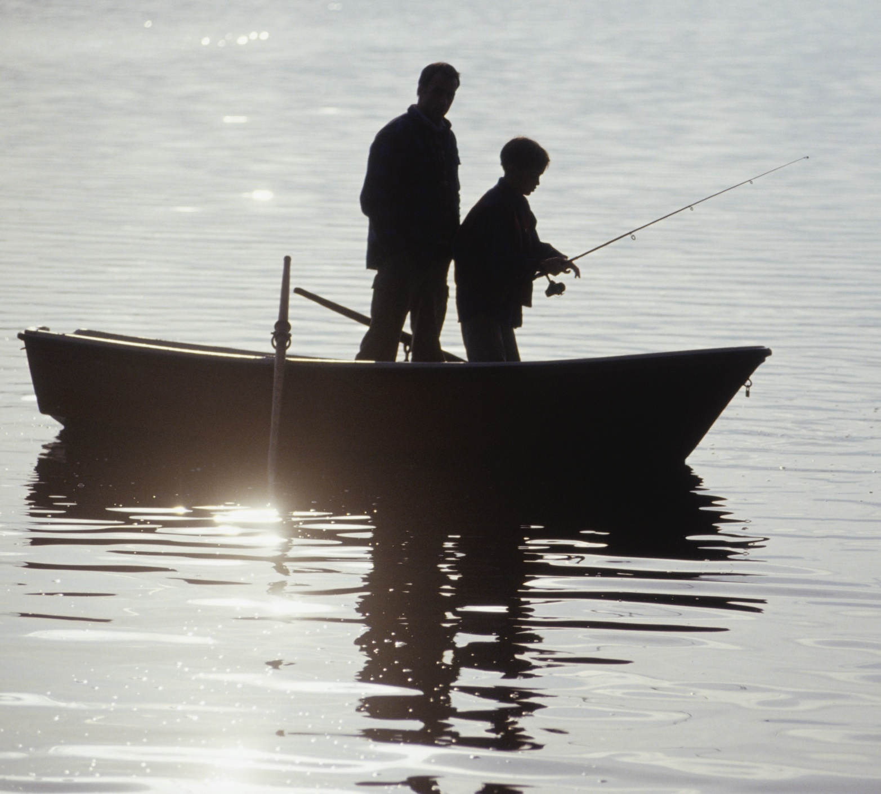
Choosing a D-Group must be intentional.
Jesus has called us to be “fishers of men.”
This involves more than merely announcing you are starting a D-Group. You must go fishing.

Slide 45
Choosing a D-Group must be intentional.
Understand the importance of prayer.

Slide 46
Choosing a D-Group must be intentional.
Understand the importance of prayer.
Understand the impact of hospitality.
“hospitality” – is philozenia. From philos, meaning “affection” and zenos, meaning “stranger.”
Hospitality in the Bible literally means, “to show kindness to a stranger” (Heb. 3:2a).

Slide 47
Choosing a D-Group must be intentional.
Understand the importance of prayer.
Understand the impact of hospitality.
Understand the initiative of leadership.

Slide 48
Connecting with a D-Group will be imperative.
Your D-Group should meet weekly for fellowship, Bible study, and prayer. You can meet anytime and anywhere.
Consistency is important!

Slide 49
Characteristics of a D-Group will be important.
One thing you notice about the
group of disciples whom Jesus
called is their diversity.

Slide 50
Characteristics of a D-Group will be important.
You want a diverse group.
  Mature Believers
  New Believers
  Unbelievers
  Multi-Generational Believers

Slide 51
Characteristics of a D-Group will be important.
You want a diverse group.
You want a defective group.

Slide 52
Characteristics of a D-Group will be important.
You want a diverse group.
You want a defective group.
You want a dedicated group.

Slide 53
Takeaways…
Intimate fellowship with other believers is an essential part of disciple-making.
You must pray about who the Lord wants you
to ask.
Practicing hospitality is critical.
continued…

Slide 54
Takeaways…
You must take the initiative to call people to join your group.
You want to have as much diversity as possible.
You must be a dedicated disciple maker.

Slide 55
Group Assignment
Where are your current “fishing holes?”
Where could you create some
new fishing holes?

Slide 56

Teaching
D-Life
Practice
#2
Mark 4:1-2a, 10
Lesson 3

Slide 57
A key word related to the teaching of D-Life is the word “simple.”

Slide 58
The D-Group Weekly Study Guide
is a simple tool that provides a daily Bible reading plan and a weekly study guide for your D-Group (pgs. 15-16).

Slide 59
Main Thought…
Daily Bible reading, storytelling, and group discussion are simple and highly effective teaching techniques for making disciples.

Slide 60
Mark 4:1-2a, 10
He began to teach beside the sea. And a very large crowd gathered about Him, so that He got into a boat . . . And He was teaching them many things in parables…. And when He was alone, those around Him with the twelve asked Him about the parables.

Slide 61
1. Lead your group to read the Bible.
To learn more about Jesus and to follow Him we must read the Bible. There is simply no substitute for daily Bible reading.

Slide 62
In D-Life, we have a very simple
Bible reading plan.
Our goal is to read one chapter from the Bible, five days a week. This goal is so simple there is no excuse not to achieve it.

Slide 63
2. Lead your group to apply the Bible.
A major goal of daily Bible reading is personal application. Through D-Life, you will learn how to find personal application points from every chapter you read.

Slide 64
Personal Application Questions
S-P-A-C-E
Is there a…
Sin to confess?
Promise to claim?
Attitude to change?
Command to obey?
Example to follow?

Slide 65
Group Assignment
Find a personal application from Matthew 4:18-25
Matthew 4 [Circle One: S P A C E ]
Personal Study Notes:
____________________________________________________________________
________________________________________________________________________________________________________________________________________________________________________________________________________________________________________________________________________________
Sin to Confess / Promise to Claim / Attitude to Change / Command to Obey / Example to Follow.

Slide 66
Weekly Accountability Questions
Did everyone read your daily Bible reading assignments?
What are some of the application points you found?

Slide 67
3. Lead your group to story through the Bible.
Any committed believer can teach like Jesus by using stories.

Slide 68
4. Lead your group to discuss the Bible.
When Jesus was alone with His disciples, they shared in group discussions where they would unwrap the meanings of His
stories and teachings.

Slide 69
Facilitate the Bible Study
Using the Weekly Study Guide Questions
Don’t talk too much.
Be encouraging.
Keep a good pace.
Get everyone in the group involved.

Slide 70
Facilitate the Bible Study
Using the Weekly Study Guide Questions
Stop someone from dominating.
Stay on point.
Lead with sound biblical doctrine.
Always be confidential.

Slide 71
5. Lead your group to prepare to multiply.
Remember that your ultimate goal as a D-Group Leader is to make disciples who make disciples.

Slide 72
Your D-Group Weekly Assignments
#1: Lead Prayer Time
#2: Tell the Story/Paraphrase
#3: Read the Text
#4: Facilitate Bible Study

Slide 73
Your D-Group Weekly Agenda
Fellowship Time
Prayer Time (Pray)
Accountability Time
Story Time (Tell)
Bible Reading (Read)
Bible Study (Facilitate)
Ministry Planning
Weekly Assignments
Closing Prayer

Slide 74
Your D-Group Disciple-Making Tools
(Our Zebco 33 in Fishing for Men)
Your D-Life Disciple-Making tools will make it simple. These tools will equip and empower you for a lifestyle of disciple-making.

Slide 75

D-LIFE ONLINE
Four full years of D-Life Weekly Study Guides
Electronic / Printable
(Pages 15 & 16)
Get your D-Life Online
“Self Sign Up Link”

Slide 76




D-LIFE JOURNALS
New Testament
1 & 2
Old Testament
1 & 2

Slide 77

D-LIFE FOR FAMILIES
D-Life Boot Camps
An Excellent Tool
for Family
Discipleship by Josh Wilks

Slide 78
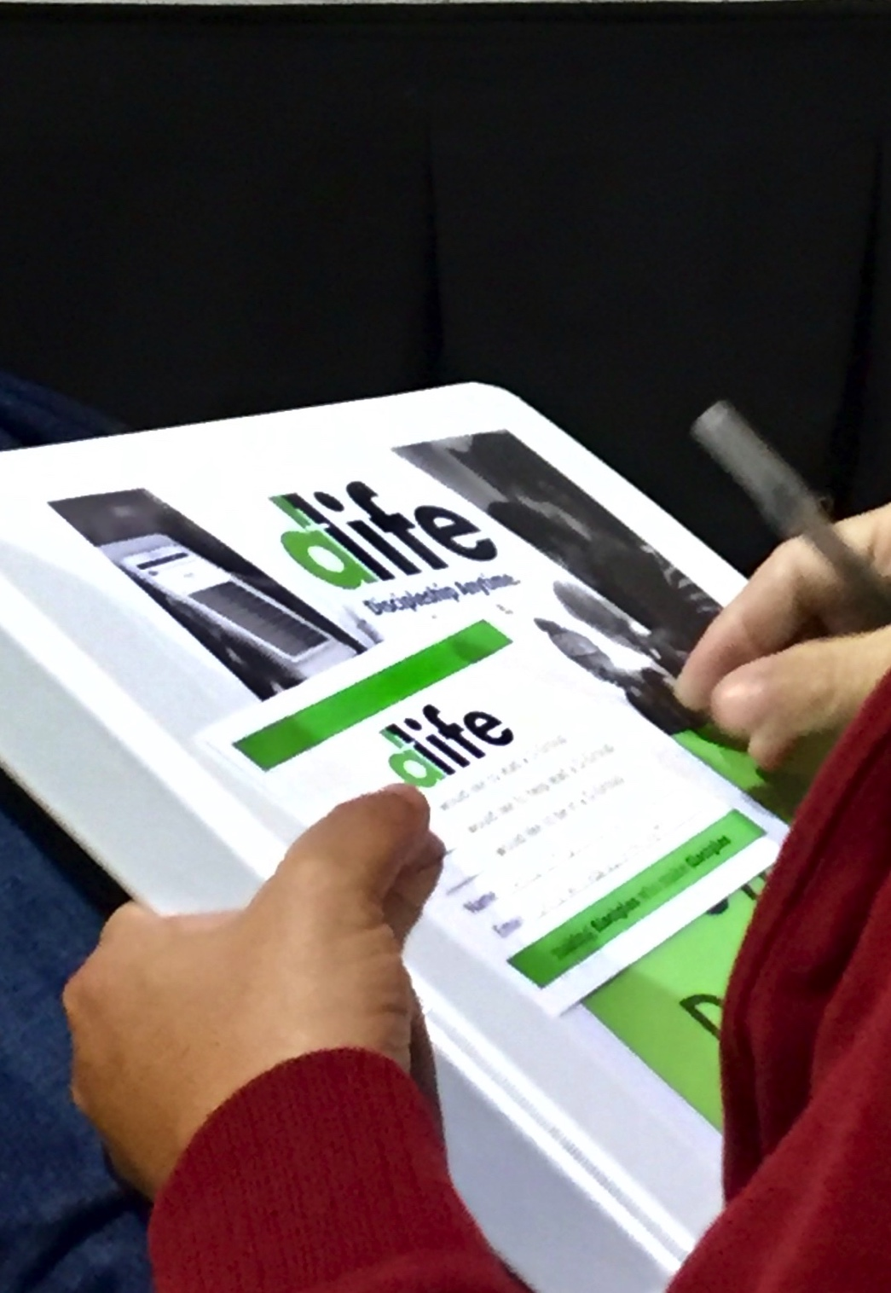
D-LIFE TRAINING
D-Life Boot Camps
Excellent resources for
training your people

Slide 79

THE GREATER WORK
A Great Book on Disciple- Making

Slide 80

LIFE’S STORY: BROKENNESS
TO BEAUTY
D-Life Boot Camps
A Simple
Evangelism Tool

Slide 81

THE REVIVE BIBLE NT
A Marked NT for Sharing the Gospel

Slide 82
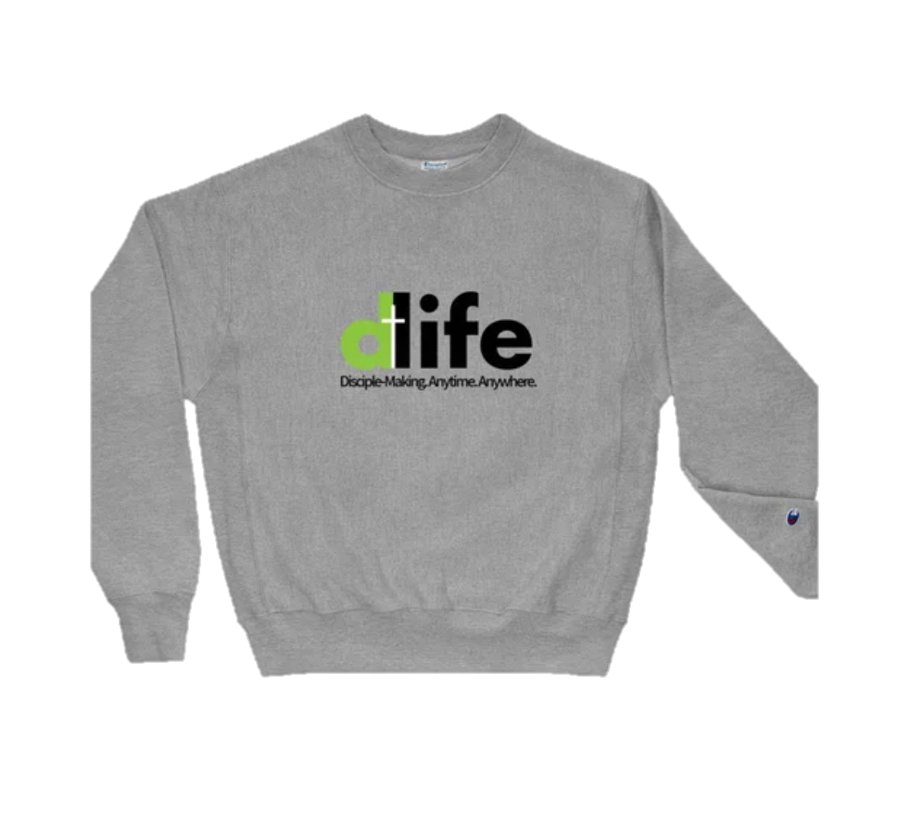
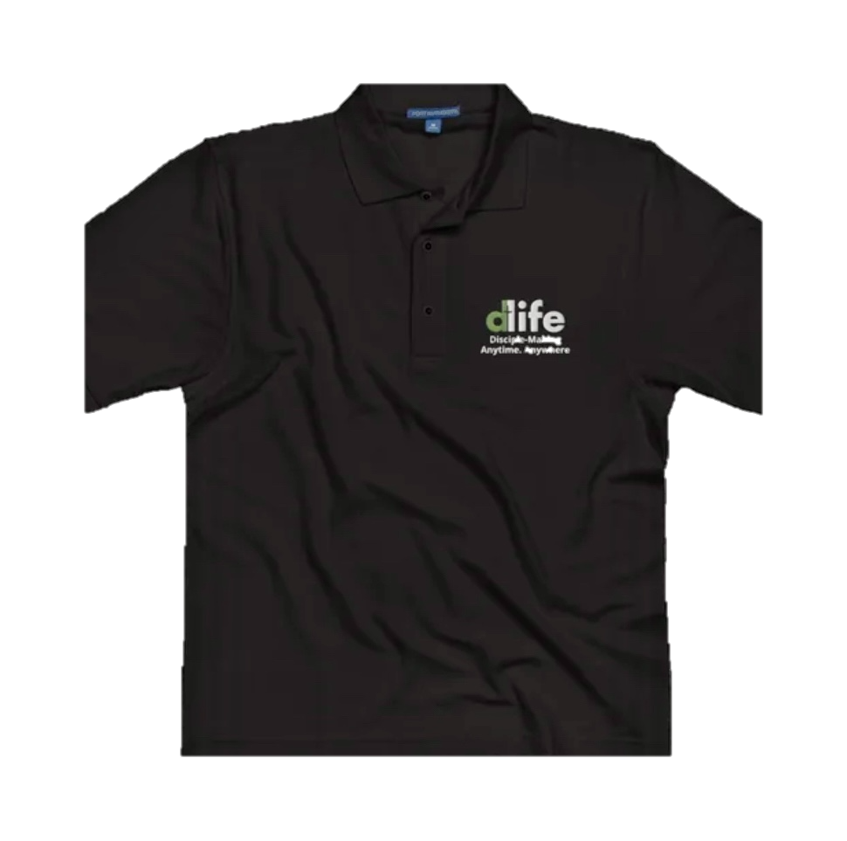
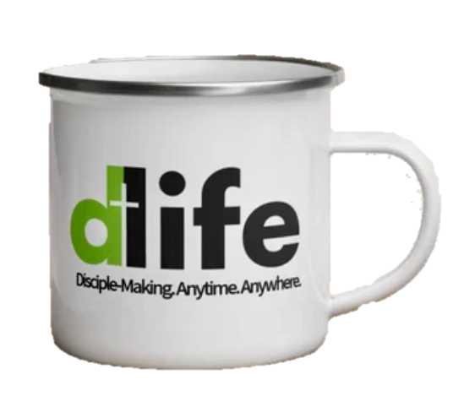

D-LIFE
SHRITS &
ACCESSORIES
How to Share
D-Life with Others

Slide 83
For All of These Resources
Visit the D-Life Online Store…
www.livethedlife.com/store

Slide 84
Follow Us on Facebook
www.facebook.com/livingthedlife
#dlife

Slide 85
Takeaways…
A key word related to the teaching of D-Life is the word simple.
Lead your group to read the Bible.
Lead your group to apply the Bible.
continued…

Slide 86
Takeaways…
Lead your group to story through the Bible.
Lead your group to discuss the Bible.
Lead your group to prepare to multiply.

Slide 87
Break Time
Men & Women’s
Model D-Group Meetings
Sample 1 Study Guide (Page 15)
Sample 2 Study Guide (Page 16)

Slide 88
The 6 Practices of Disciple-Making
Part 2

Slide 89
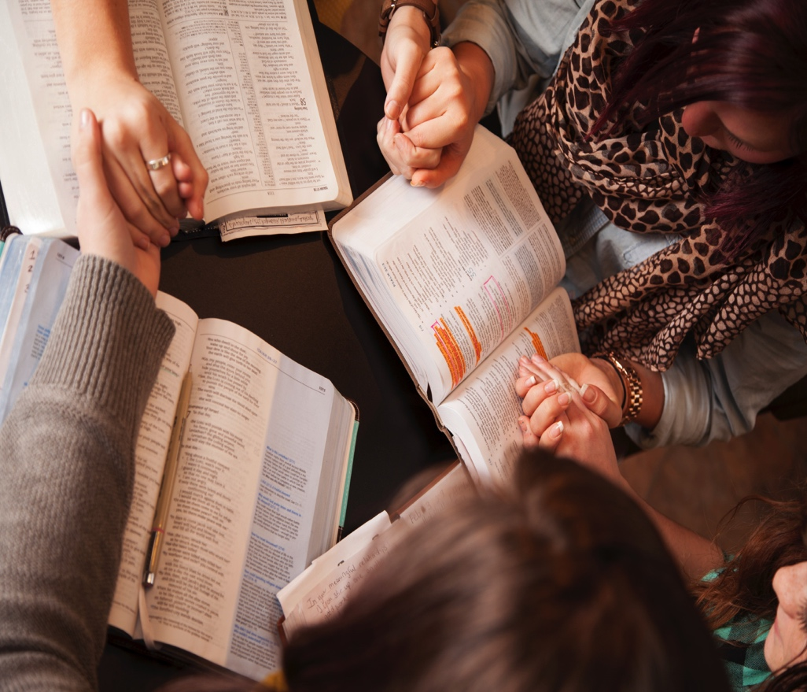
Prayer
D-Life
Practice
#3
Matthew 6:9-13
Lesson 4

Slide 90
So far, we have discussed the first two of the six practices of disciple-making.
Now let’s turn our attention to the third practice, which is The Prayer of D-Life.

Slide 91
Few things in life are more needed but more neglected than the power of fervent prayer.

Slide 92
Main Thought…
Disciple-making involves praying with others and practicing the discipline of prayer in our daily lives.

Slide 93
Matthew 6:9-13
Pray then like this: Our Father in heaven, hallowed be your name. Your kingdom come, your will be done, on earth as it is in heaven. Give us this day our daily bread, and forgive us our debts, as we also have forgiven our debtors. And lead us not into temptation,
but deliver us from evil.

Slide 94
Teach your group the priority of prayer.
Prayer is a great privilege. We must not neglect it. In every D-Group we must teach and model the priority of fervent prayer.

Slide 95
Model for your group the practice of prayer.
As we pray together in our D-Groups, we learn the practice of prayer
from one another.

Slide 96


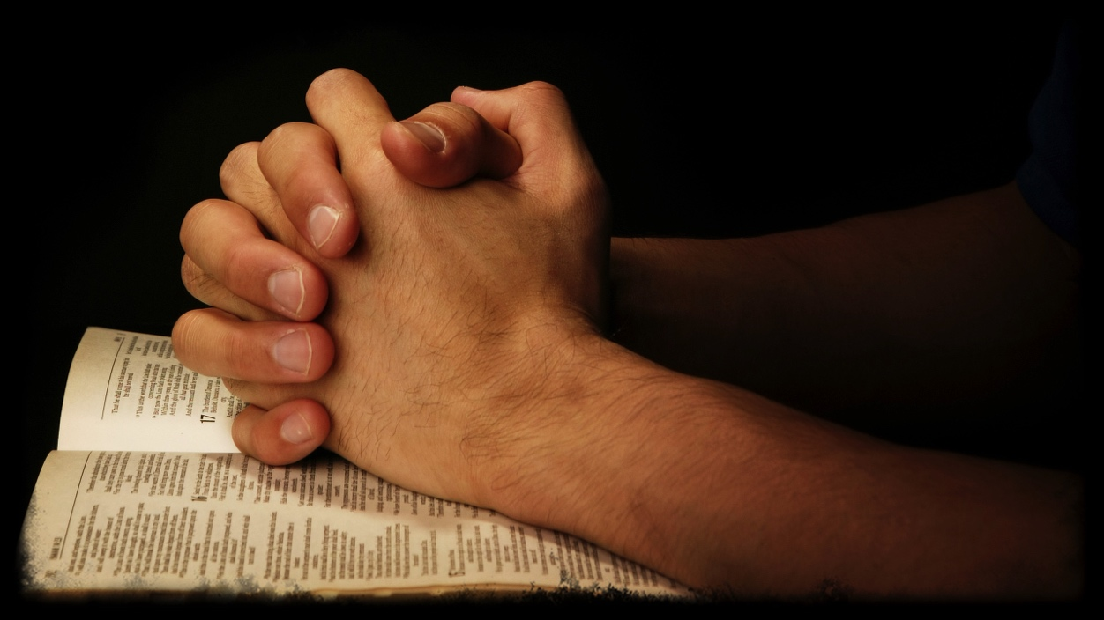
A Model for Fervent Prayer
Adoration
Confession
Thanksgiving
Supplication

Slide 97
Nurture in your group faith in prayer.
One thing all D-Groups MUST do every time they meet is to pray for revival and the spiritual healing of our land.

Slide 98
2 Chronicles 7:14
If My people who are called by My name humble themselves, and pray and seek My face and turn from their wicked ways, then I will hear from heaven and will forgive their
sin and heal their land.

Slide 99
Takeaways…
D-Groups must commit to the daily spiritual discipline of personal prayer.
D-Groups must pray together weekly and keep notes on prayer requests.
D-Groups must pray every week for revival
and for the spiritual healing of our land.

Slide 100
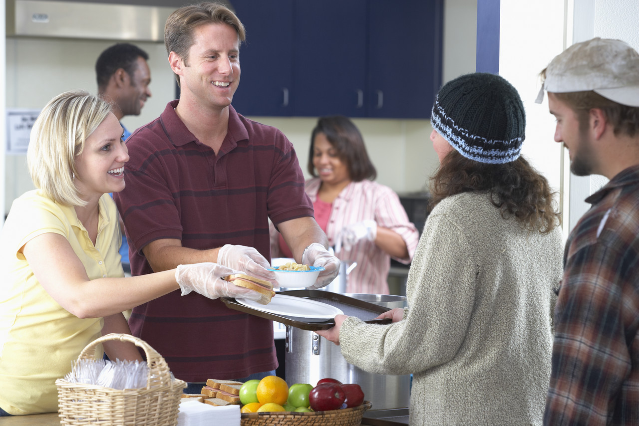
Ministry
D-Life
Practice
#4
Mark 6:7, 12-13
Lesson 5

Slide 101
We deceive ourselves if we think we can disciple others from a classroom only.
Disciple-making requires a lab, and the world is our lab. Making disciples must involve on-the-job training in ministry and evangelism.

Slide 102

3-Fold Purpose of a D-Life D-Group
To grow in spiritual maturity.
To serve in missional ministry.
To reproduce disciple makers.

Slide 103
Main Thought…
Disciple-making involves doing the work of ministry and evangelism outside the walls of the church.

Slide 104
Mark 6:7, 12-13
He called the twelve and began to send them out two by two… So they went out and proclaimed that people should repent. And they cast out many demons and anointed with oil many who were sick and healed them.

Slide 105
Lead your group to plan meaningful ministry projects.
Jesus called His disciples to do the
work of ministry and evangelism that they had observed Him doing.

Slide 106
Lead your group to go out and do meaningful ministry projects.
Once you make plans for a ministry project, lead your group to go do it.

Slide 107
The MINIMUM GOAL of every D-Group is to work together on one community ministry and evangelism project every two months.

Slide 108
Lead your group to practice “lift up your eyes” evangelism.
The purpose of all D-Group ministry projects is servant evangelism.

Slide 109
LIFE’S STORY: BROKENNESS
TO BEAUTY
D-Life Boot Camps
A Simple
Evangelism Tool

Slide 110
THE REVIVE
BIBLE NT
A Marked NT
for Sharing
the Gospel

Slide 111
When you lead others to Christ, try to immediately connect them with a D-Group.

Slide 112
Takeaways…
The 3-fold purpose of a D-Group is to grow in spiritual maturity, to serve in missional ministry, and to reproduce disciple makers.
Lead your group to plan meaningful ministry projects.
continued…

Slide 113
Takeaways…
Lead your group to go out and do meaningful ministry projects.
Lead your group to practice “life up your eyes” evangelism.
continued…

Slide 114
Takeaways…
The minimum goal of every D-Group is to work together on one community ministry and evangelism project every two months.

Slide 115

Multiplication
D-Life
Practice
#5
2 Timothy 2:1-2
Lesson 6

Slide 116
The Kingdom principle of multiplying disciples is the most necessary and neglected practice of disciple-making.

Slide 117
Main Thought…
Disciple-making requires the multiplication of disciples;
apart from multiplication there
is no real discipleship.

Slide 118
2 Timothy 2:1-2
You then, my child, be strengthened by the grace that is in Christ Jesus, and what you have heard from me in the presence of many witnesses entrust to faithful men who will be able to teach others also.

Slide 119
Multiplication is empowered.
We can be filled with dynamite-like power for the purpose of multiplying disciples.

Slide 120
Multiplication is explained.
Multiplication is God’s plan
for how His kingdom is to grow.

Slide 121
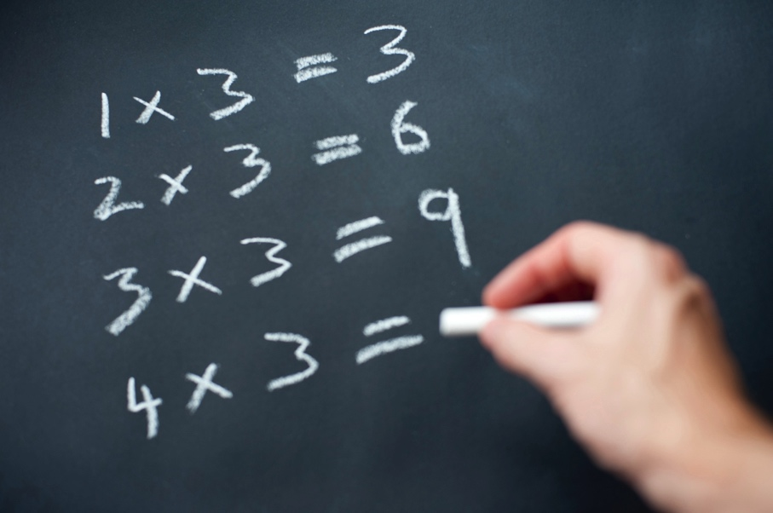
The Simple Plan
Every D-Group multiplies yearly.
Every D-Group has at least three disciples.

Slide 122
The Remarkable Results
Y1 = 1 D-Group / 3 Others
Y2 = 2 D-Groups / 6 Others
Y3 = 4 D-Groups / 12 Others
Y4 = 8 D-Groups / 24 Others

Slide 123
The Remarkable Results
Y05 = 16 D-Groups / 48 Others
Y10 = 512 D-Groups / 1,536 Others
Y20 = 524,228 D-Groups / 1,572,864 Others
Y30 = 500M< D-Groups / 1.5B< Others

Slide 124
Wow! What if only half
of this happened?
Exponential kingdom growth
is the ultimate result of
multiplying disciples.

Slide 125
Multiplication is expected.
Paul had invested in Timothy. Now
Timothy must invest in others for the
disciple-making process to continue.

Slide 126
Multiplication is expected.
We must have the dedication of a soldier.

Slide 127
2 Timothy 2:3-4
Share in suffering as a good soldier of Christ Jesus. No soldier gets entangled in civilian pursuits, since his aim is to please the one who enlisted him.

Slide 128
Multiplication is expected.
We must have the dedication of a soldier.
We must have the discipline of an athlete.

Slide 129
2 Timothy 2:5
An athlete is not crowned unless he competes according to the rules.

Slide 130
Multiplication is expected.
We must have the dedication of a soldier.
We must have the discipline of an athlete.
We must have the diligence of a farmer.

Slide 131
2 Timothy 2:6-7
It is the hard-working farmer who ought to have the first share of the crops. Think over what I say, for the
Lord will give you understanding in everything.

Slide 132
The greatest reward of disciple- making is multiplication.

Slide 133
Through D-Life you have four years
of weekly study guides.
This gives you time to diligently
equip those who are ready to lead and to patiently invest in those who need more growth.

Slide 134
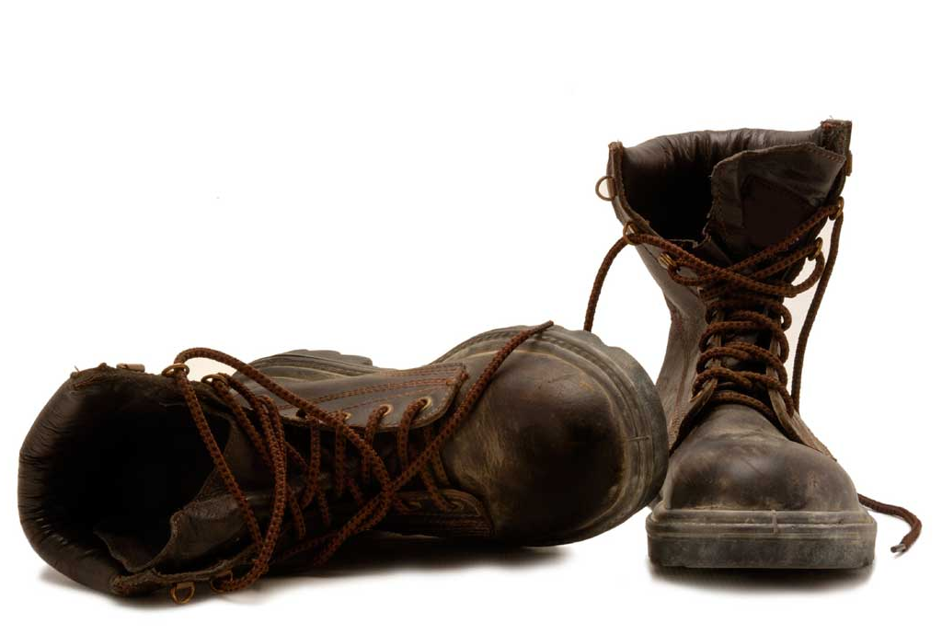
The on-going training of new
D-Group leaders is essential.
D-LIFE
BOOT CAMP
TRAINING
Encourage new leaders to step
up to lead.
Enlist new leaders for D-Life training.

Slide 135
Multiplication of is exciting.
A lifetime lifestyle of making and multiplying disciples is the ultimate
D-Life commitment.

Slide 136
Takeaways…
Multiplying disciples is what God has called you to do.
Multiplying disciples is what God will empower you to do.
continued…

Slide 137
Takeaways…
Multiplying disciples is what God will reward you to do.
Multiplying disciples will result in the exponential growth of God’s kingdom.

Slide 138
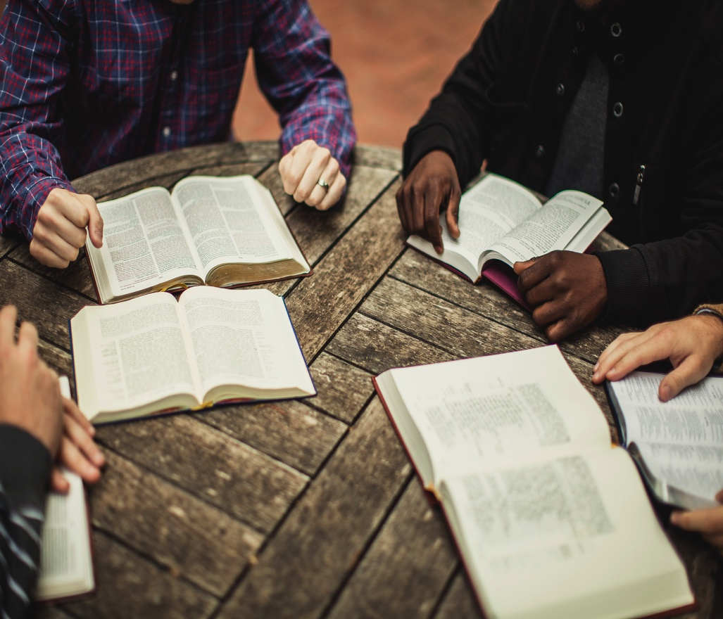
Accountability
D-Life
Practice
#6
Matthew 26:34-35
Lesson 7

Slide 139
Unfortunately, it is not uncommon for people to feel they are not up to the task for living a life of disciple-making.

Slide 140
Main Thought…
Disciple-making involves loving spiritual accountability in the context of a caring relational environment.

Slide 141
Matthew 26:34-35
Jesus said to him, “Truly, I tell you, this very night, before the rooster crows you will deny me three times.” Peter said to Him, “Even if I must die with you, I will not deny you!”

Slide 142
Lives are changed through spiritual accountability.
In our D-Groups, we hold one another accountable in three important areas
of spiritual development.

Slide 143
Lives are changed through spiritual accountability.
Accountability to the Word of God.

Slide 144
Lives are changed through spiritual accountability.
Accountability to the Word of God.
Accountability to our walk with God.

Slide 145
Lives are changed through spiritual accountability.
Accountability to the Word of God.
Accountability to our walk with God.
Accountability to our work and witness for God.

Slide 146
Leaders are called through spiritual accountability.
Jesus’ example of loving accountability with Peter is an example to follow.

Slide 147
The Risen Jesus went to Peter to hold
him accountable to his commitment.
Three times Peter denied Jesus, and
three times Jesus said to Peter, “Feed
my sheep” (John 21:3-17).

Slide 148
Regardless of Peter’s issues and failures, Jesus reminded him that he was called to be a disciple-maker.
The same is true for us. We have no good excuse to not live the D-Life.

Slide 149
Let us commit to a lifestyle of disciple-making.
To be a disciple maker is a priority commitment.

Slide 150
Let us commit to a lifestyle of disciple-making.
To be a disciple maker is a priority commitment.
To be a disciple maker is a personal commitment.

Slide 151
I pray that you will make a lifetime commitment to living the D-Life.

Slide 152
Takeaways…
Jesus has called you to be a disciple maker.
You are empowered to be a disciple maker.
Will you commit to be a disciple maker?

Slide 153
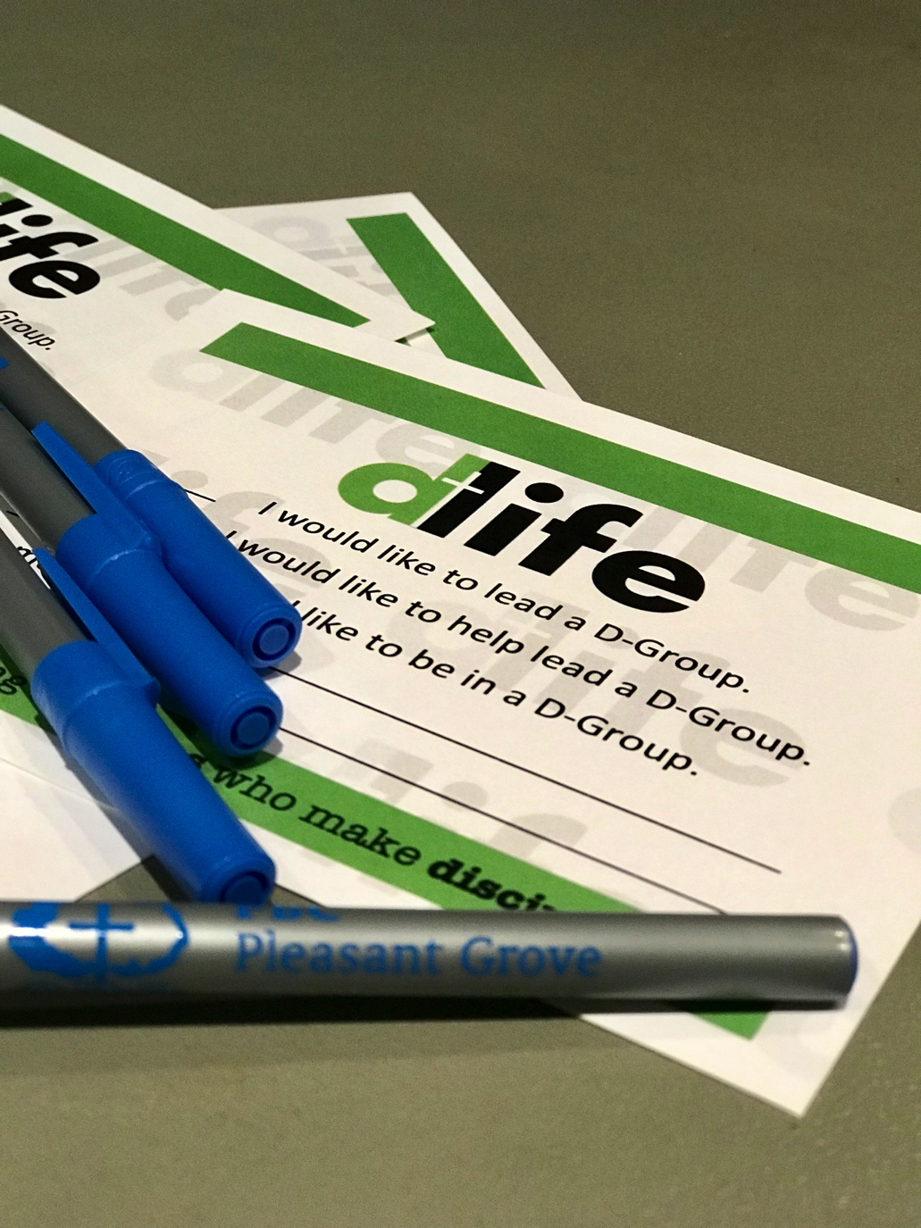
Group Assignment
Fill out your D-Life Commitment Card.
I would like to lead
a D-Group.
I would like to help lead a D-Group.
I would like to be
in a D-Group.

Slide 154
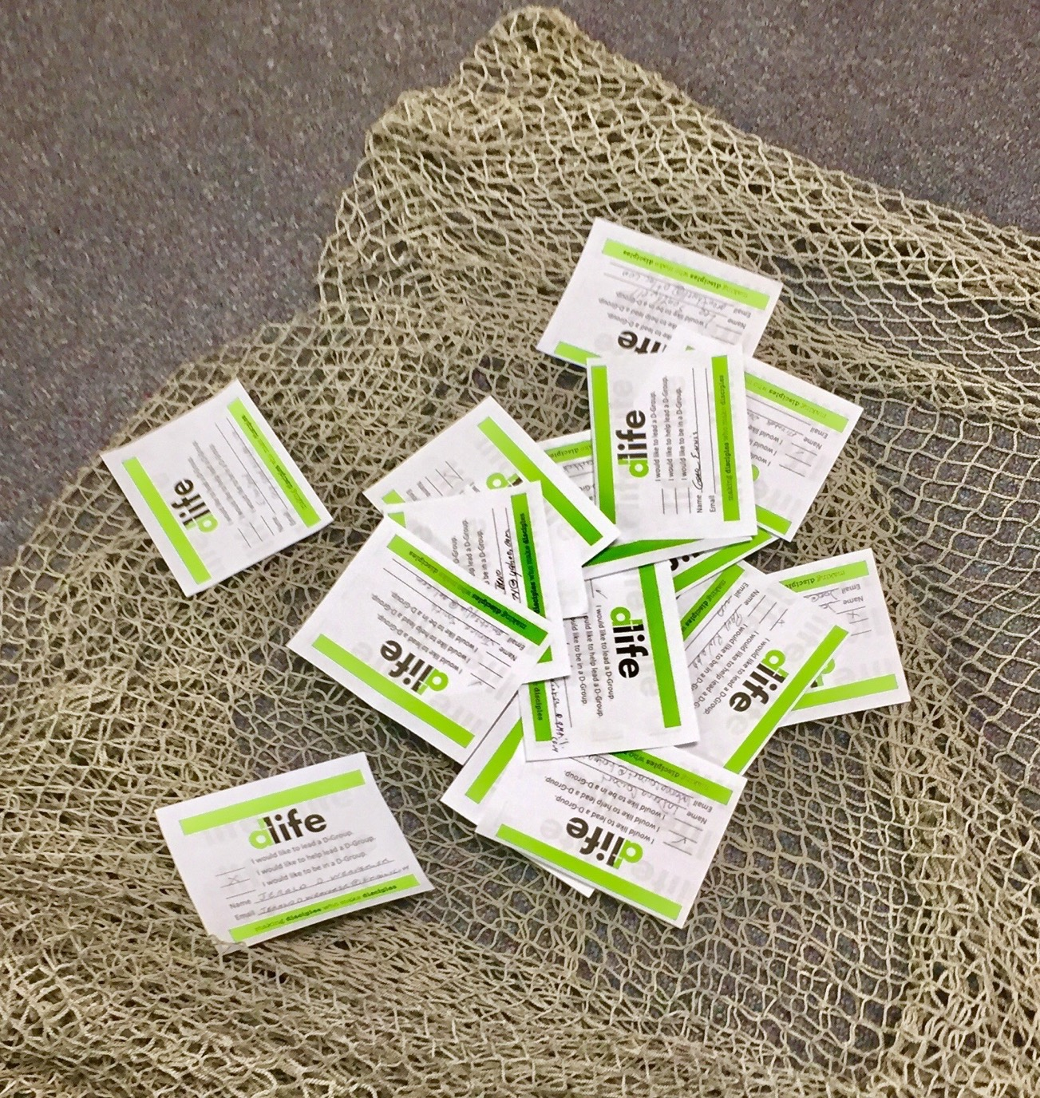
Group Assignment
Bring your card and lay it down in the net.

Slide 155
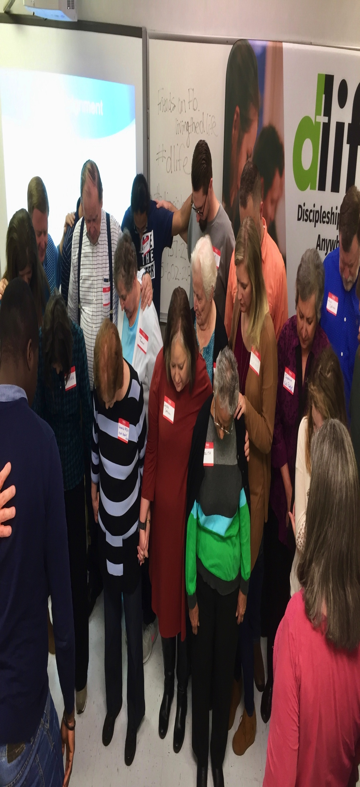
Group Assignment
Let’s pray for a mighty movement of God.

